Slide 1

Capstone Final Project: Plume Analysis
Justin Tice & Megan Hoeksema
March 1, 2023

Slide 2
Background

Slide 3
Research Questions
Characterize the sensors’ performance and operation. Are they all working properly at all times? Can you detect any unexpected behaviors of the sensors through analyzing the readings they capture?
Now turn your attention to the chemicals themselves. Which chemicals are being detected by the sensor group? What patterns of chemical releases do you see, as being reported in the data?
Which factories are responsible for which chemical releases? Carefully describe how you determined this using all the data you have available. For the factories you identified, describe any observed patterns of operation revealed in the data.

Slide 4
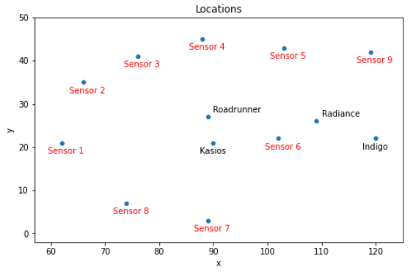
Datasets
Sensor data containing 3 months of readings
Meteorological data
Location data

Slide 5
Data Preparation
Sensor Data
Rename column titles. The Date Time column has a whitespace at the end.
Convert the date time column to datetime in order to create visualizations.
Set the datetime as the index.
No null values.
Meteorological Data
Location Data
Data was provided in word file.
Pandas DF manually created.

Slide 6
Characterize the sensors’ performance and operation. Are they all working properly at all times?

Slide 7
Can you detect any unexpected behaviors of the sensors through analyzing the readings they capture?

Slide 8
Which chemicals are being detected by the sensor group?

Slide 9
What patterns of chemical releases do you see, as being reported in the data?

Slide 10
What patterns of chemical releases do you see, as being reported in the data?

Slide 11
Which factories are responsible for which chemical releases?

